Slide 1
SQALE - Technical Debt
The term technical debt refers to delayed tasks and immature artifacts that constitute a "debt" because they incur extra costs in the future in the form of increased cost of change during evolution and maintenance.
The term technical debt is defined as the cost to improve technical quality up to a level that is considered ideal.
The interest of technical debt is the extra cost spent on maintaining software as a result of poor technical quality.

Slide 2
The cost of technical debt can be broken down three ways as follows:
1. Principal. This is the amount of effort in dollars that it would take to fully service the technical debt.
2. Recurring interest. This is the cost to the organization for holding onto the debt
3. Compounding interest. This is the additional technical debt that accrues over time.

Slide 3
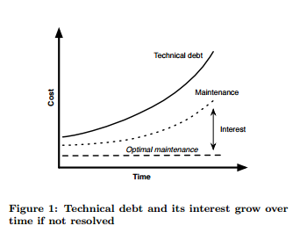

Slide 4
SQALE
Technical debt measurement needs a quality framework to formulize quality of the system and the ideal quality.
SQALE method (Software Quality Assessment based on Life Cycle Expectations)
The debt evaluated with SQALE is the internal debt associated to the source code of an application. This excludes process related debt.
The issues may come intentionally (as a way to achieve the objective of a sprint) or unintentionally. In both cases, there will be a negative impact (which means interest to pay), so this should be counted as debt by the method.

Slide 5
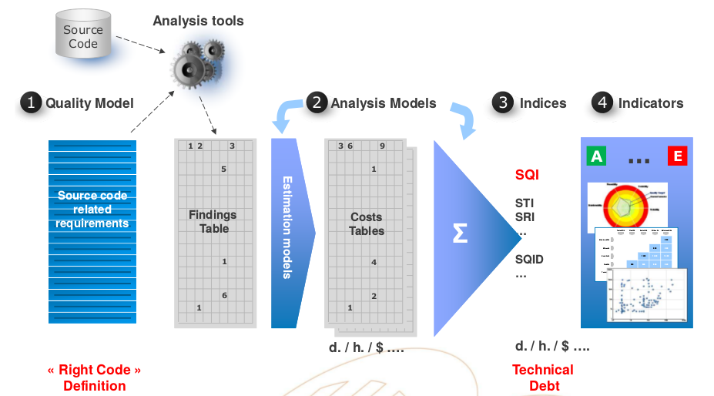

Slide 6
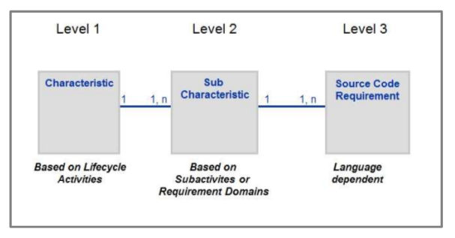
Figure : Classication

Slide 7
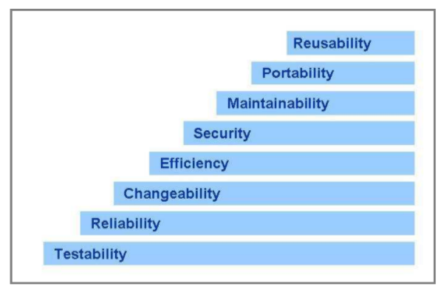
Figure : First Level

Slide 8
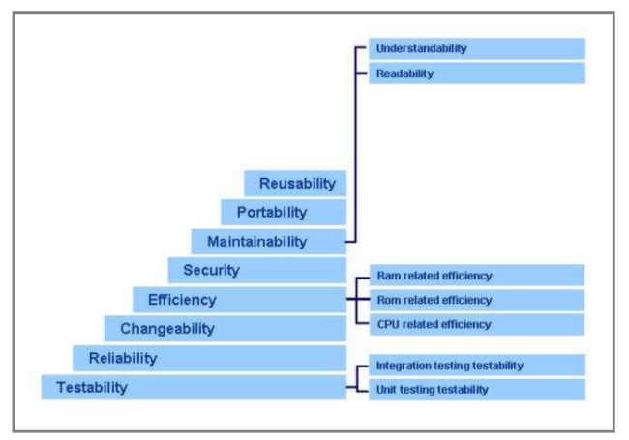
Figure : Second Level

Slide 9
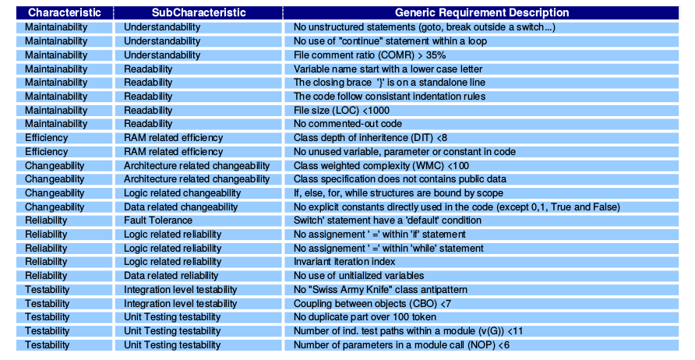

Slide 10
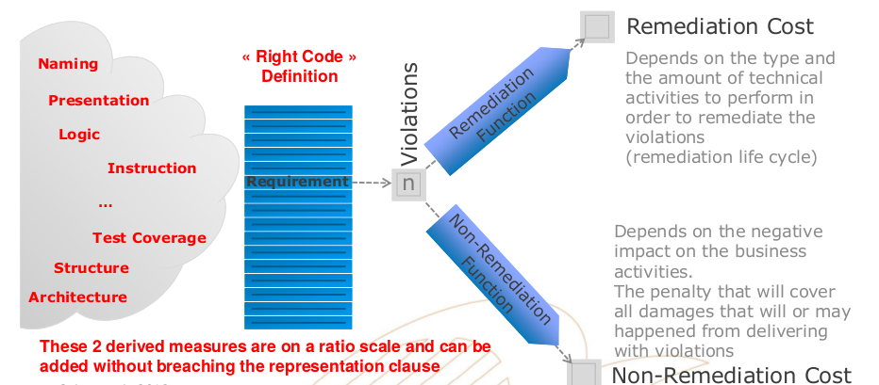
Remidiation and Non-Remidiation

Slide 11
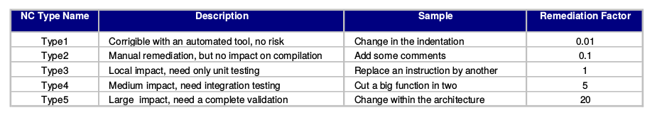

Slide 12
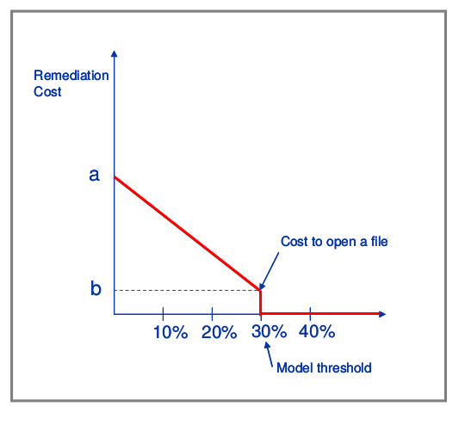
Example of a Remediation Function for the Comment Ratio

Slide 13
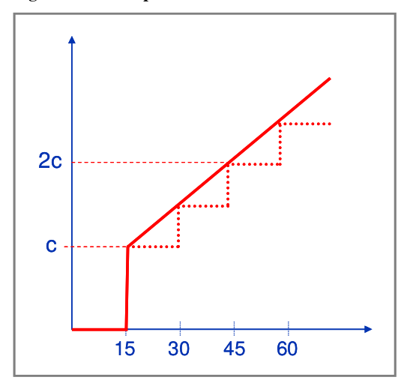
Example of a Remediation Function for Cutting an Artifact

Slide 14
THANKU

